Slide 1
Definition and process of COMMUNICATION

Slide 2
The law of competition may sometimes be hard for the individual, but… it is best for the race, simply because IT ENSURES THE SURVIVAL OF THE FITTEST in every department.
Andrew Carnegie

Slide 3
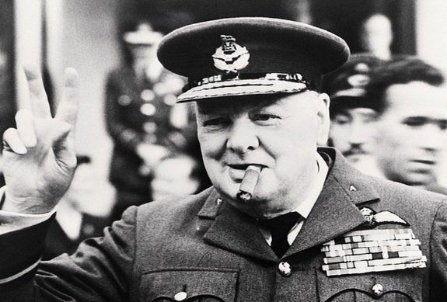
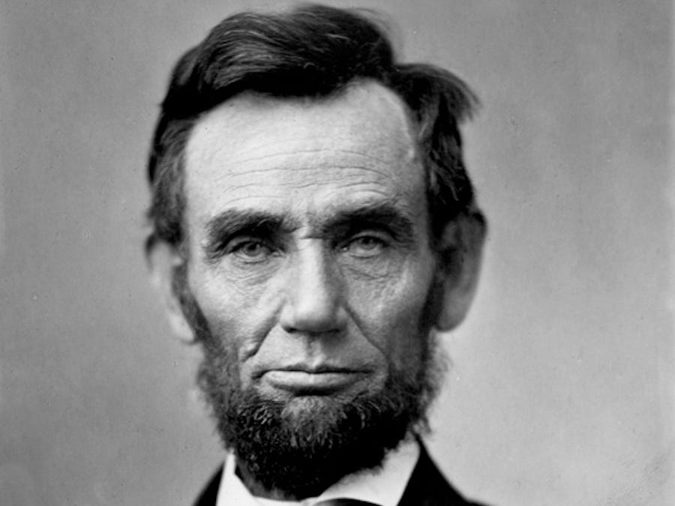
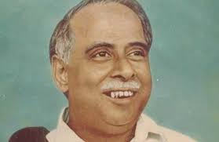
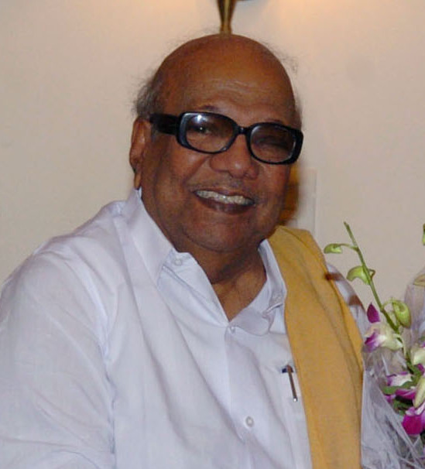
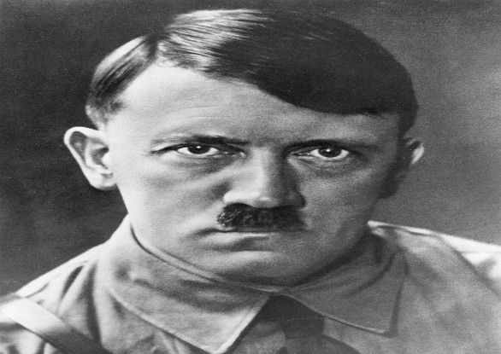
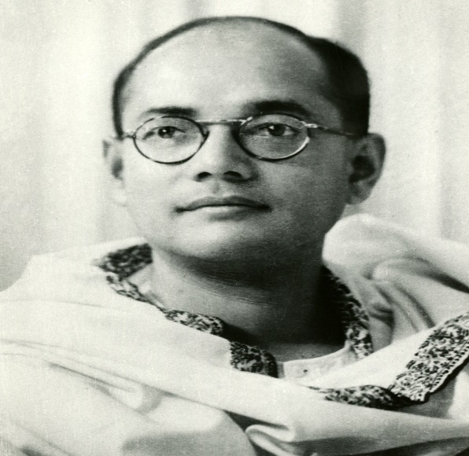
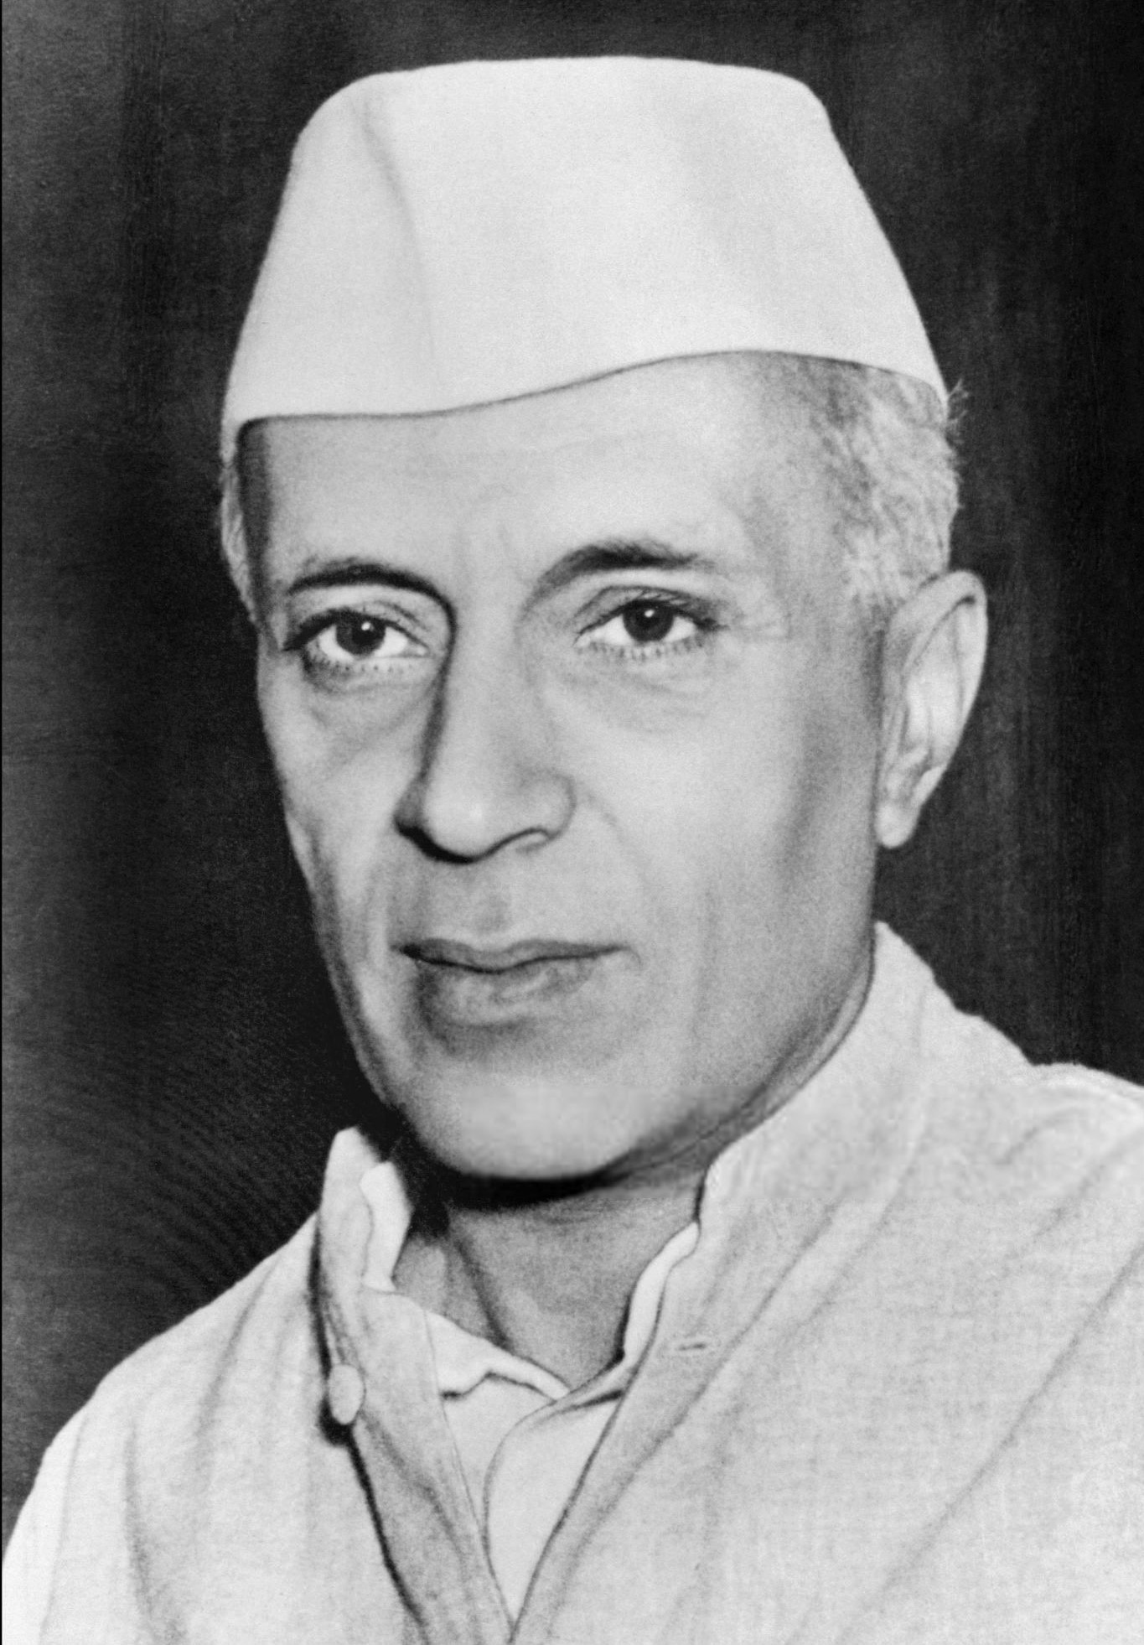
Preparation
Proficiency in academics alone is not an assurance to master all skills.
Score is important
Other skills supplement
Worlds’ Great orators
Winston Churchill
Abraham Lincoln
Adolph Hitler
Jawaharlal Nehru
Subash Chandra Bose
C.N.Anna Durai
Kalaigar Karunanithi

Slide 4

Communication
natural phenomenon
genetically inbuilt in all forms of life like human beings, animals.
an art to express one’s feelings, ideas and emotions effectively and fruitfully

Slide 5
DEFINITION OF COMMUNICATION
Communication is the transmission of information, ideas, emotions, skills, etc., by the use of symbol, words, pictures, figures, graphs, and other means.
Communication is commonly defined as “ the imparting or interchange of thoughts, opinions, or information by speech, writing, or signs”.
Communication is the process by which we understand others and in turn endeavor to be understood by them. It is dynamic, constantly changing and shifting in response to the total situation.

Slide 6
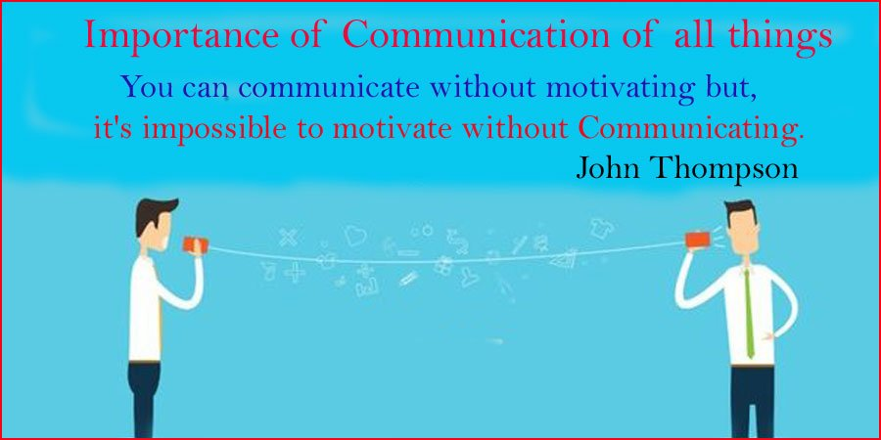
Importance of communication
Globalised context – Public speaking, Documentation , Speking with authority
Increasing confidence
Communicate the purpose and relevance of work
Expressing thoughts and articulating accomplishments and attributes
Achieve success

Slide 7
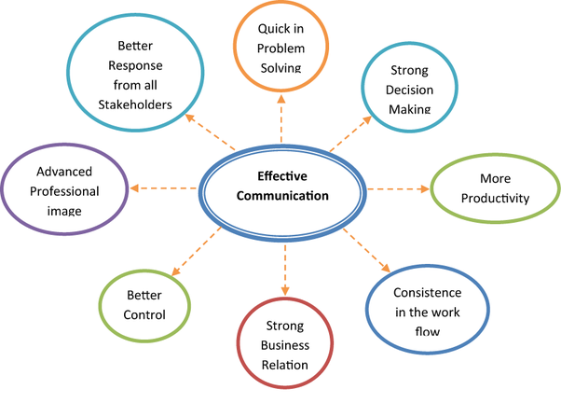

Slide 8
Communication in Business
Business involves a lot of Communication
Communication is a major and
essential part of the work of
business.

Slide 9
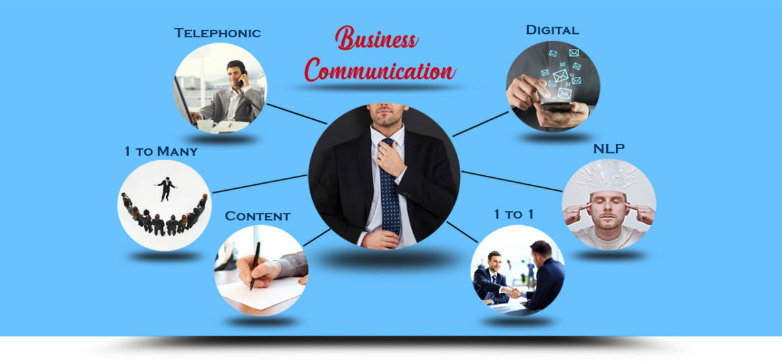

Slide 10
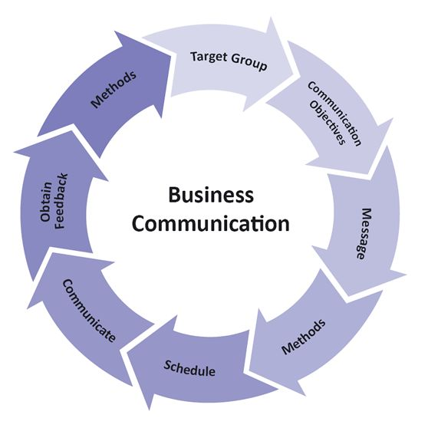
Industry needs good Communicators
Industry needs people with good Communication
Skills
85% recruiters give priority to Communicators
performance largely judged by Communicating
abilities
higher The Communicating Skills, the better position
one needs to improve the Communicating ability

Slide 11
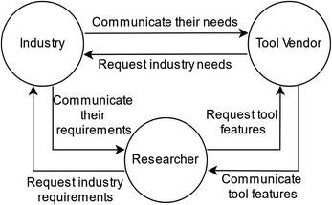
Why INDUSRTY needs to Communicate.
Workers receive and send information,
Process with computers –
write messages – fill forms
Give and receive orders -
Contact people over phone-
sell – instruct –
Periodical summaries so on
Oral, -most part
written – records
computer – letters, E-mails , messages , reports
To have all this organized efforts – Industry needs Good Communicator

Slide 12
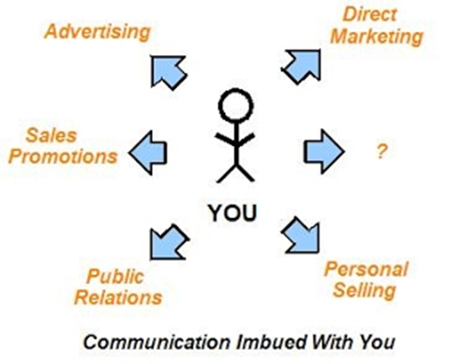
Cont…
Communicating enables people to work together
It is a vehicle through which management performs its basic functions.
Hence Managers direct through Communication
Coordinate the entire Business through Communication
Coordinate the staff –plan and control through Communication

Slide 13
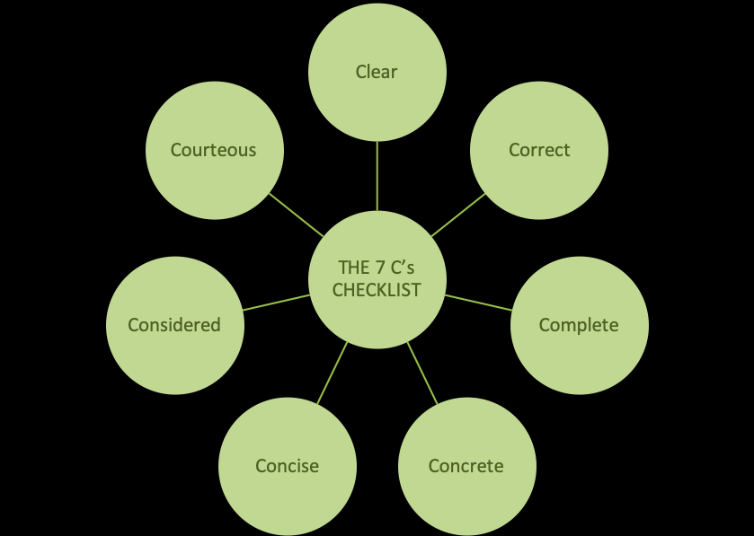
Essentials of good language
Be clear about the purpose
Understand the process of communication
Be clear about the target audience
Develop good communication skills
Be well informed
Plan your communication
Be positive in your approach
Appreciate the time factor
Be cost conscious
Obtain feedback

Slide 14
Major parts in communication
55% Body language – postures, gestures, and eye contact
38% tone of voice
7% words

Slide 15

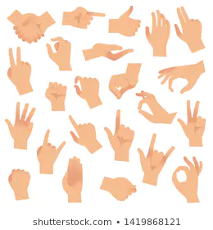


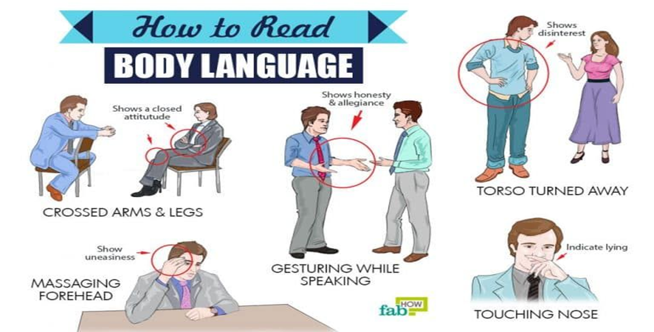

Slide 16
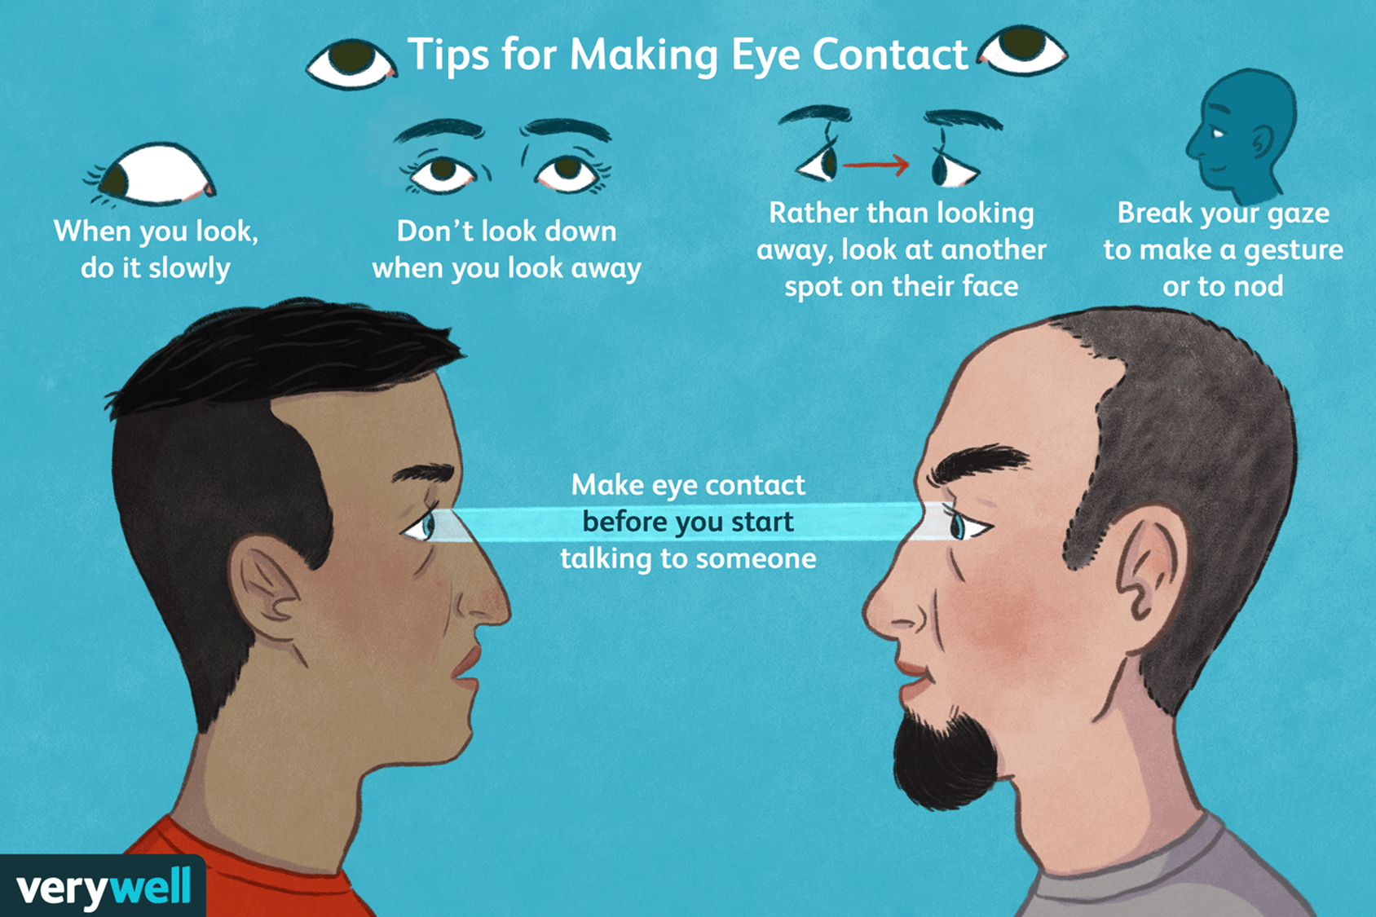

Slide 18
PROCESS OF COMMUNICATION
source
Decoding
Receiver
Encoding
Channel
Feedback

Slide 19
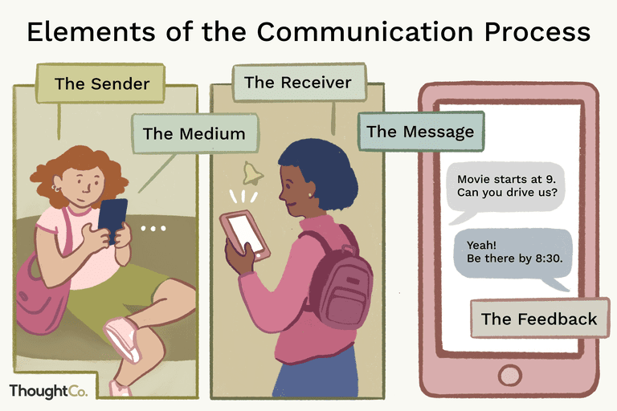

Slide 20
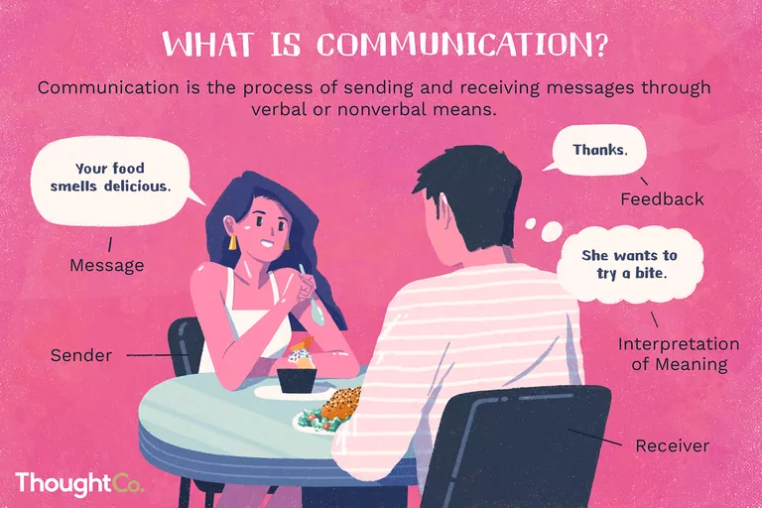

Slide 21

Forms of Communication:
Verbal – speech, words,
Non-verbal - winks, smile, tap, waves,
Pictures, symbols, signs
Hieroglyphics- secret codes,
Body language –gestures, signs

Slide 22
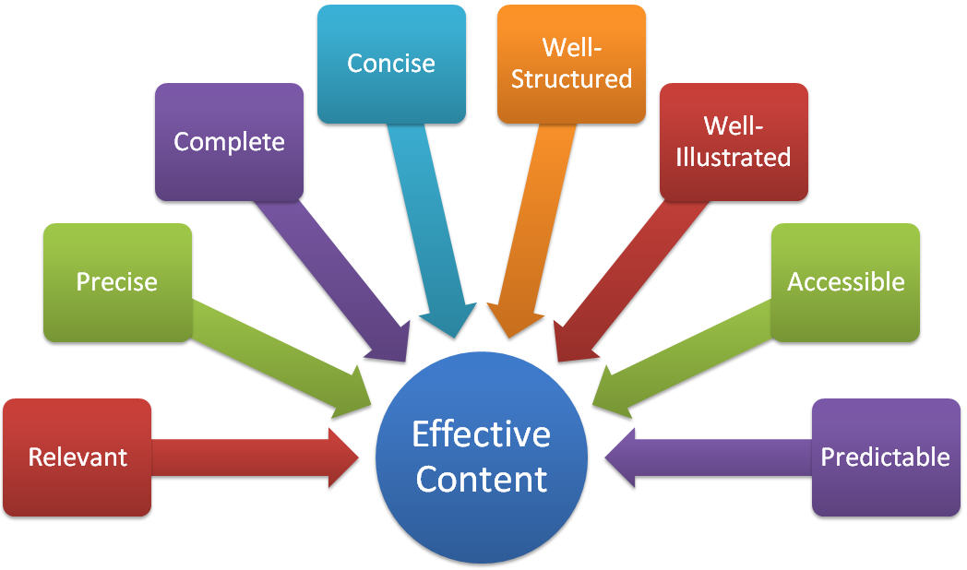
Basic Ingredients:
Clarity
Accuracy
Empathy (ability to understand)
Sincerity
Relaxation
Eye contact
Posture
Modulation of voice

Slide 23
Thank you

